Slide 1
Chapter 18 : Concurrency Control

Slide 2
Outline
Lock-Based Protocols
Multiple Granularity
Handling Deadlocks
Phantom Handling
Timestamp-Based Protocols

Slide 3
Concurrency Control
A database must provide a mechanism that will ensure that all possible schedules are
either conflict or view serializable, and
are recoverable and preferably cascadeless
Concurrency-control protocols allow concurrent schedules, but ensure that the schedules are conflict/view serializable, and are recoverable and cascadeless
Different concurrency control protocols provide different tradeoffs between the amount of concurrency they allow and the amount of overhead that they incur.

Slide 4
Lock-Based Protocols
A lock is a mechanism to control concurrent access to a data item
Data items can be locked in two modes :
1. exclusive (X) mode. Data item can be both read as well as written. X-lock is requested using lock-X instruction.
2. shared (S) mode. Data item can only be read. S-lock is requested using lock-S instruction.
Lock requests are made to concurrency-control manager. Transaction can proceed only after request is granted.

Slide 5
Lock-Based Protocols (Cont.)
Lock-compatibility matrix
A transaction may be granted a lock on an item if the requested lock is compatible with locks already held on the item by other transactions
Any number of transactions can hold shared locks on an item,
But if any transaction holds an exclusive lock on the item no other transaction may hold any lock on the item.
Notes:
If a lock cannot be granted, the requesting transaction is made to wait till all incompatible locks held by other transactions have been released. The lock is then granted.

Slide 6
Lock-Based Protocols (Cont.)
Example of a transaction performing locking:
T₂: lock-S(A);
read (A);
unlock(A);
lock-S(B);
read (B);
unlock(B);
display(A+B)
Locking as above is not sufficient to guarantee serializability

Slide 7
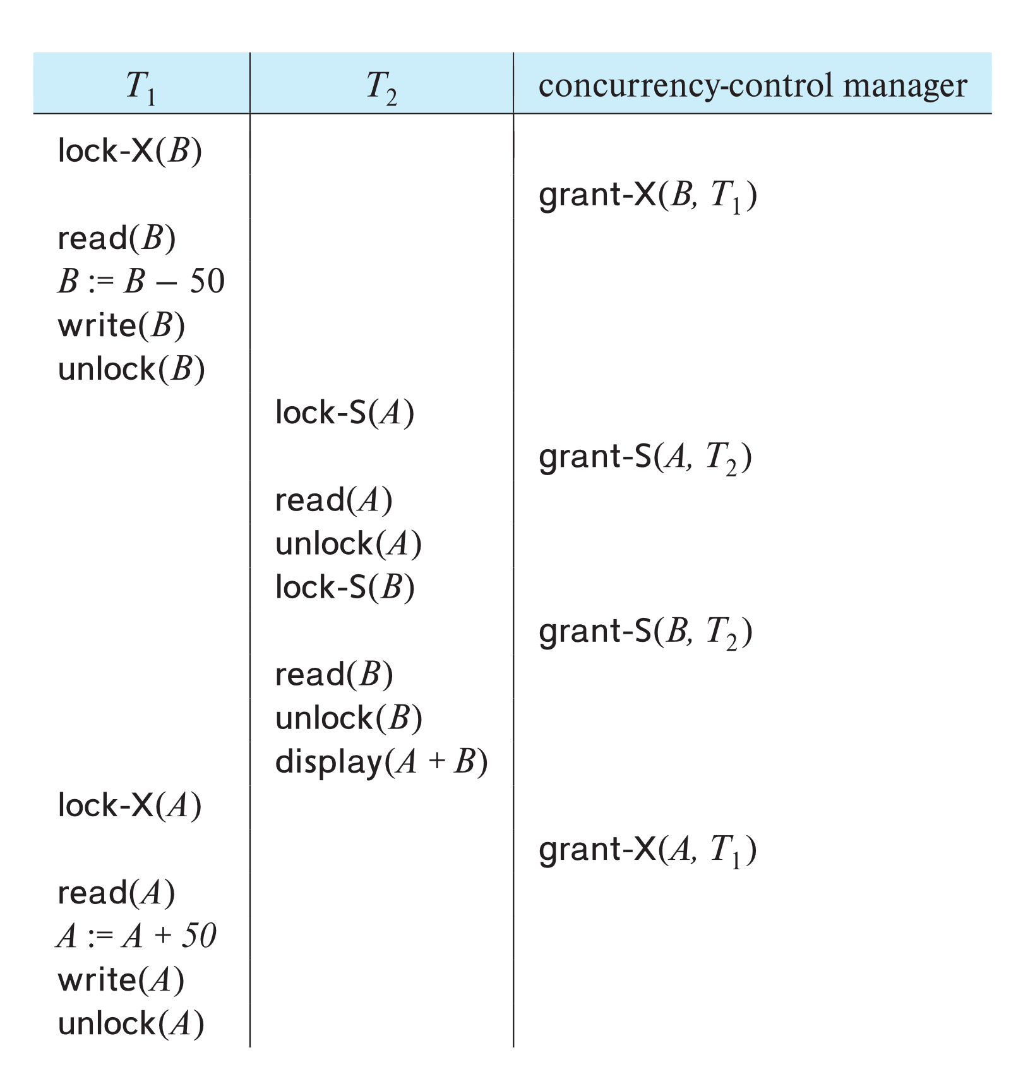
Schedule With Lock Grants
Grants omitted in rest of chapter
Assume grant happens just before the next instruction following lock request
This schedule is not serializable (why?)
A locking protocol is a set of rules followed by all transactions while requesting and releasing locks, to enforce serializability

Slide 8
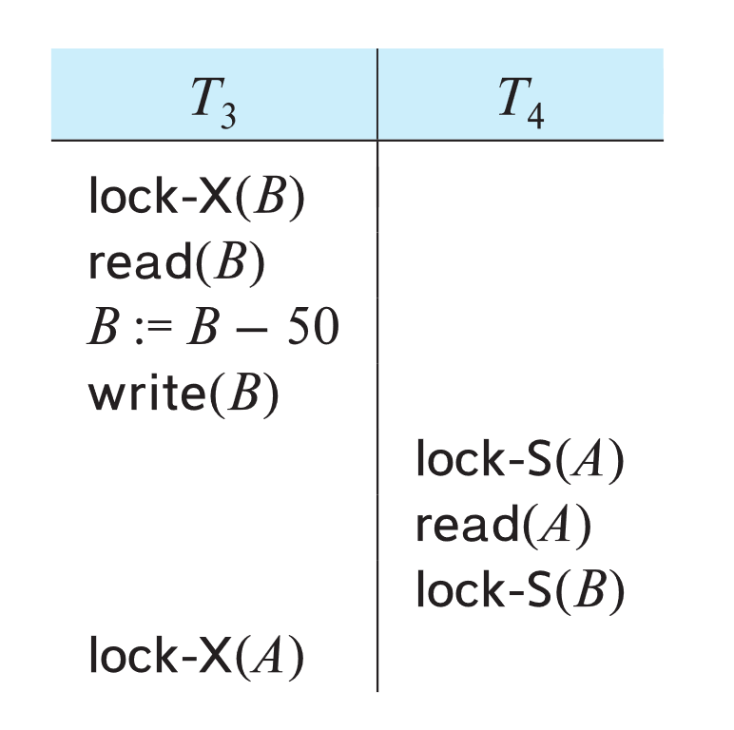
Deadlock
Consider the partial schedule
Neither T₃ nor T₄ can make progress — executing lock-S(B) causes T₄ to wait for T₃ to release its lock on B, while executing lock-X(A) causes T₃ to wait for T₄ to release its lock on A.
Such a situation is called a deadlock.
To handle a deadlock one of T₃ or T₄ must be rolled back and its locks released.

Slide 9
Deadlock (Cont.)
The potential for deadlock exists in most locking protocols. Deadlocks are a necessary evil.
Starvation is also possible if concurrency control manager is badly designed. For example:
A transaction may be waiting for an X-lock on an item, while a sequence of other transactions request and are granted an S-lock on the same item.
The same transaction is repeatedly rolled back due to deadlocks.
Concurrency control manager can be designed to prevent starvation.

Slide 10
The Two-Phase Locking Protocol
A protocol which ensures conflict-serializable schedules.
Phase 1: Growing Phase
Transaction may obtain locks
Transaction may not release locks
Phase 2: Shrinking Phase
Transaction may release locks
Transaction may not obtain locks
The protocol assures serializability. It can be proved that the transactions can be serialized in the order of their lock points (i.e., the point where a transaction acquired its final lock).
Locks
Time

Slide 11
Lock Conversions
Two-phase locking protocol with lock conversions:
– Growing Phase:
can acquire a lock-S on item
can acquire a lock-X on item
can convert a lock-S to a lock-X (upgrade)
– Shrinking Phase:
can release a lock-S
can release a lock-X
can convert a lock-X to a lock-S (downgrade)
This protocol ensures serializability

Slide 12
The Two-Phase Locking Protocol (Cont.)
Two-phase locking does not ensure freedom from deadlocks
Extensions to basic two-phase locking needed to ensure freedom from cascading roll-back
Strict two-phase locking: a transaction must hold all its exclusive locks till it commits/aborts.
Ensures recoverability and avoids cascading roll-backs
Rigorous two-phase locking: a transaction must hold all locks till commit/abort.
Transactions can be serialized in the order in which they commit.
Most databases implement rigorous two-phase locking, but refer to it as simply two-phase locking
Two-phase locking is not a necessary condition for serializability

Slide 13
Multiple Granularity of Locking
Allow data items to be of various sizes and define a hierarchy of data granularities, where the small granularities are nested within larger ones
Can be represented graphically as a tree (see next slide)
When a transaction locks a node in the tree explicitly, it implicitly locks all the node's descendants in the same mode.
Granularity of locking
Fine granularity (lower in tree): high concurrency, high locking overhead
Coarse granularity (higher in tree): low locking overhead, low concurrency

Slide 14
Example of Granularity Hierarchy
The levels, starting from the coarsest (top) level are
database
area (each area consists of files, no file in more than one area)
file
record
Lock granularity escalation: in case there are too many locks at a particular level, switch to higher granularity lock

Slide 15
Deadlock Handling
System is deadlocked if there is a set of transactions such that every transaction in the set is waiting for another transaction in the set.

Slide 16
Deadlock Handling
Deadlock prevention protocols ensure that the system will never enter into a deadlock state.
Some prevention strategies:
Require that each transaction locks all its data items before it begins execution (pre-declaration).
Impose partial ordering of all data items and require that a transaction can lock data items only in the order specified by the partial order

Slide 17
Deadlock Prevention (Cont.)
Timeout-Based Schemes:
A transaction waits for a lock only for a specified amount of time. After that, the wait times out and the transaction is rolled back.
Ensures that deadlocks get resolved by timeout if they occur
Simple to implement
But may roll back transaction unnecessarily in absence of deadlock
Difficult to determine good value of the timeout interval.
Starvation is also possible

Slide 18
More Deadlock Prevention Strategies
wait-die scheme — non-preemptive
Older transaction may wait for younger one to release data item.
Younger transactions never wait for older ones; they are rolled back instead.
A transaction may die several times before acquiring a lock
wound-wait scheme — preemptive
Older transaction wounds (forces rollback) of younger transaction instead of waiting for it.
Younger transactions may wait for older ones.
Fewer rollbacks than wait-die scheme.
In both schemes, a rolled back transactions is restarted with its original timestamp.
Ensures that older transactions have precedence over newer ones, and starvation is thus avoided.

Slide 19
Deadlock Detection
Wait-for graph
Vertices: transactions
Edge from T_{i} →T_{j}. : if T_{i} is waiting for a lock held in conflicting mode by T_{j}
The system is in a deadlock state if and only if the wait-for graph has a cycle.
Invoke a deadlock-detection algorithm periodically to look for cycles.
Wait-for graph without a cycle
Wait-for graph with a cycle

Slide 20
Deadlock Recovery
When deadlock is detected :
Some transaction will have to be rolled back (made a victim) to break deadlock cycle.
Select that transaction as victim that will incur minimum cost
Rollback -- determine how far to roll back transaction
Total rollback: Abort the transaction and then restart it.
Partial rollback: Roll back victim transaction only as far as necessary to release locks that another transaction in cycle is waiting for
Starvation can happen (why?)
One solution: oldest transaction in the deadlock set is never chosen as victim

Slide 21
Phantom Phenomenon
Example of phantom phenomenon.
A transaction T1 that performs predicate read (or scan) of a relation
select count(*) from instructor where dept_name = 'Physics'
and a transaction T2 that inserts a tuple while T1 is active but after predicate read
insert into instructor values ('11111', 'Feynman', 'Physics', 94000)
(conceptually) conflict in spite of not accessing any tuple in common.
Can also occur with updates
E.g. update Wu’s department from Finance to Physics
Another Example: T1 and T2 both find maximum instructor ID in parallel, and create new instructors with ID = maximum ID + 1
Both instructors get same ID, not possible in serializable schedule

Slide 22
Handling Phantoms
Locking rules for insert/delete operations
An X-lock must be obtained on an item before it is deleted
A transaction that inserts a new tuple into the database is automatically given an X-lock on the tuple
Ensures that
reads/writes conflict with deletes
Inserted tuple is not accessible by other transactions until the transaction that inserts the tuple commits

Slide 23
Index Locking To Prevent Phantoms
Index locking protocol to prevent phantoms
Every relation must have at least one index.
A transaction can access tuples only after finding them through one or more indices on the relation
A transaction T_{i} that performs a lookup must lock all the index leaf nodes that it accesses, in S-mode
A transaction T_{i} that inserts, updates or deletes a tuple t_{i} in a relation r must obtain X-locks on all index leaf nodes affected by the insert/update/delete
The rules of the two-phase locking protocol must be observed
Guarantees that phantom phenomenon won’t occur

Slide 24
Timestamp Based Concurrency Control

Slide 25
Timestamp-Based Protocols
Each transaction T_{i} is issued a timestamp TS(T_{i}) when it enters the system.
Each transaction has a unique timestamp
Newer transactions have timestamps strictly greater than earlier ones
Timestamp could be based on a logical counter
Real time may not be unique
Timestamp-based protocols manage concurrent execution such that time-stamp order = serializability order
Several alternative protocols based on timestamps

Slide 26
Timestamp-Ordering Protocol
The timestamp ordering (TSO) protocol
For each data Q maintain two timestamp values:
W-timestamp(Q) is the largest time-stamp of any transaction that executed write(Q) successfully.
R-timestamp(Q) is the largest time-stamp of any transaction that executed read(Q) successfully.
Imposes rules on read and write operations to ensure that
Any conflicting operations are executed in timestamp order
Out of order operations cause transaction rollback

Slide 27
Timestamp-Based Protocols (Cont.)
Suppose a transaction T_{i} issues a read(Q)
1. If TS(T_{i}) < W-timestamp(Q), then T_{i} needs to read a value of Q that
was already overwritten.
Hence, the read operation is rejected, and T_{i} is rolled back.
2. If TS(T_{i}) ≥ W-timestamp(Q), then the read operation is executed, and
R-timestamp(Q) is set to
max(R-timestamp(Q), TS(T_{i})).

Slide 28
Timestamp-Based Protocols (Cont.)
Suppose that transaction T_{i} issues write(Q).
1. If TS(T_{i}) < R-timestamp(Q), then the value of Q that T_{i} is producing
was needed previously, and the system assumed that that value
would never be produced.
Hence, the write operation is rejected, and T_{i} is rolled back.
2. If TS(T_{i}) < W-timestamp(Q), then T_{i} is attempting to write an
obsolete value of Q.
Hence, this write operation is rejected, and T_{i} is rolled back.
3. Otherwise, the write operation is executed, and W-timestamp(Q) is
set to TS(T_{i}).

Slide 29
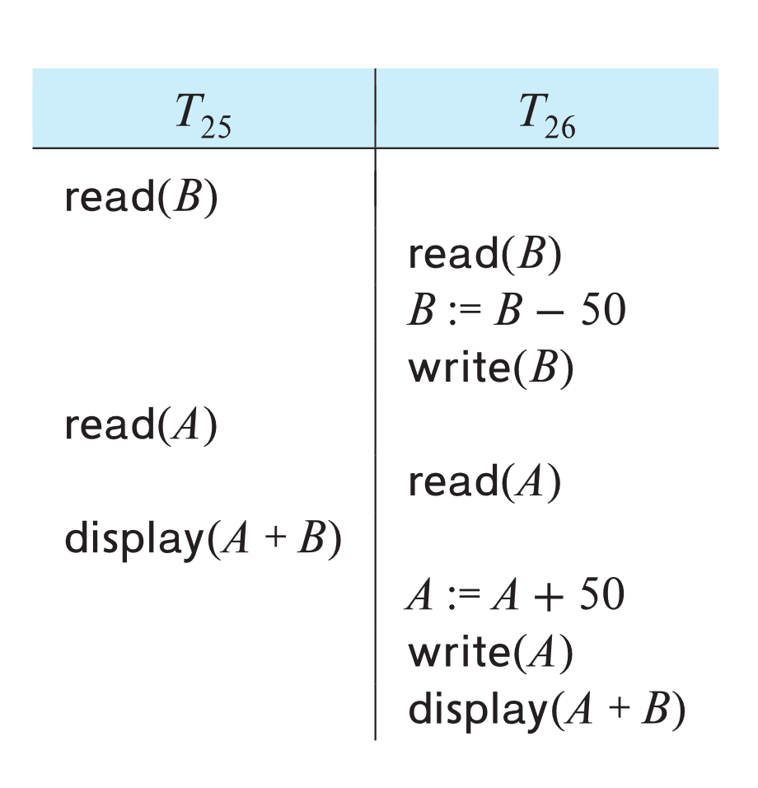
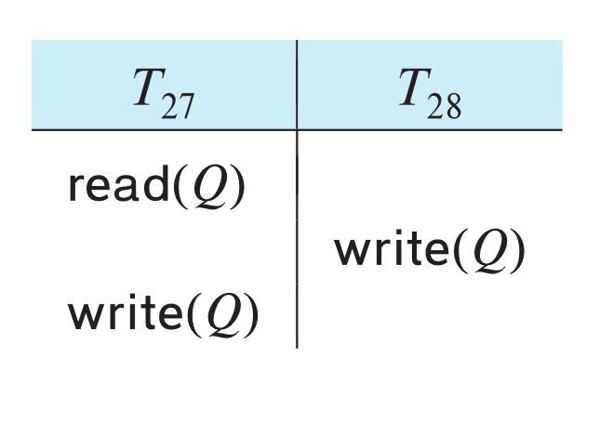
Example of Schedule Under TSO
Is this schedule valid under TSO?
Assume that initially:
R-TS(A) = W-TS(A) = 0
R-TS(B) = W-TS(B) = 0
Assume TS(T₂₅) = 25 and TS(T₂₆) = 26
How about this one, where initially R-TS(Q)=W-TS(Q)=0

Slide 30
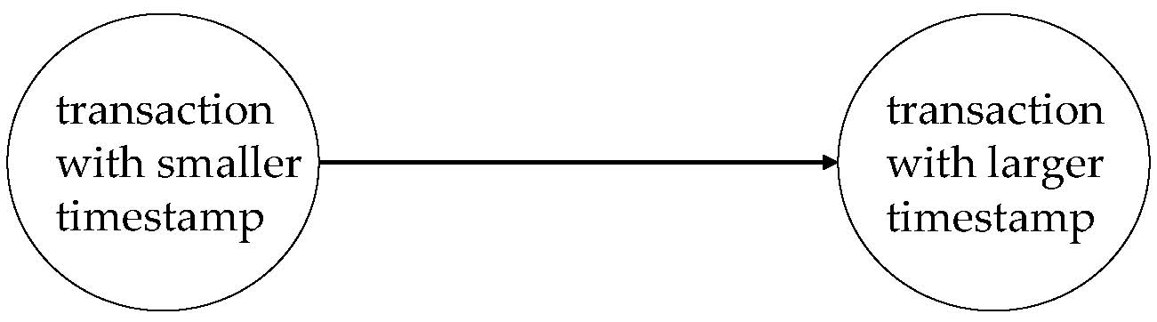
Correctness of Timestamp-Ordering Protocol
The timestamp-ordering protocol guarantees serializability since all the arcs in the precedence graph are of the form:
Thus, there will be no cycles in the precedence graph
Timestamp protocol ensures freedom from deadlock as no transaction ever waits.
But the schedule may not be cascade-free, and may not even be recoverable.

Slide 31
Thomas’ Write Rule
Modified version of the timestamp-ordering protocol in which obsolete write operations may be ignored under certain circumstances.
When T_{i} attempts to write data item Q, if TS(T_{i}) < W-timestamp(Q), then T_{i} is attempting to write an obsolete value of {Q}.
Rather than rolling back T_{i} as the timestamp ordering protocol would have done, this {write} operation can be ignored.
Otherwise this protocol is the same as the timestamp ordering protocol.
Thomas' Write Rule allows greater potential concurrency.
Allows some view-serializable schedules that are not conflict-serializable.

Slide 32
End of Chapter 18

Slide 33
Recoverability and Cascade Freedom
Solution 1:
A transaction is structured such that its writes are all performed at the end of its processing
All writes of a transaction form an atomic action; no transaction may execute while a transaction is writing
A transaction that aborts is restarted with a new timestamp
Solution 2:
Limited form of locking: wait for data to be committed before reading it
Solution 3:
Use commit dependencies to ensure recoverability

